Slide 1
Steam Store Analysis

Slide 2
About Steam Store:
Steam is a video game digital distribution service and storefront by Valve. It was launched as a software client in September 2003 as a way for Valve to provide automatic updates for their games, and expanded to distributing and offering third-party game publishers' titles in late 2005. Steam offers various features, like digital rights management (DRM), game server matchmaking, anti-cheat measures, social networking and game streaming services. It provides the user with automatic game updating, saved game cloud synchronization, and community features such as friends messaging, in-game chat and a community market.

Slide 3
About my Client:
Our client is a software developer and he wants to launch a game on Steam store.
So we have to analyze the data of the Steam store to suggest to him what will be the best genre, category etc. to launch a game So that our client can have maximum downloads and maximum positive reviews..

Slide 4
Business Problem # 1
If I require fees for the game does that means that my game will surely get more playtime because people are going to play if they have paid for it?

Slide 5
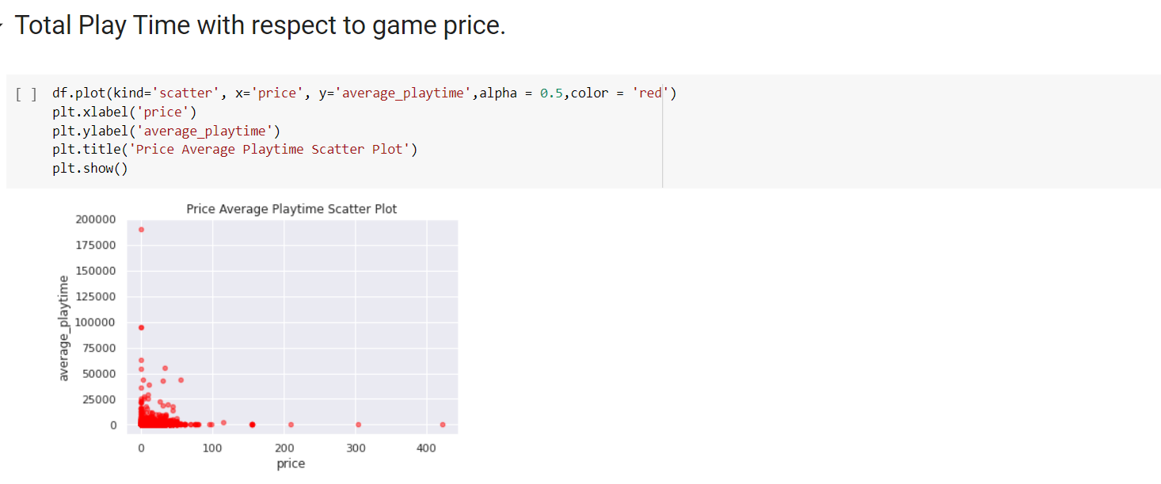

Slide 6
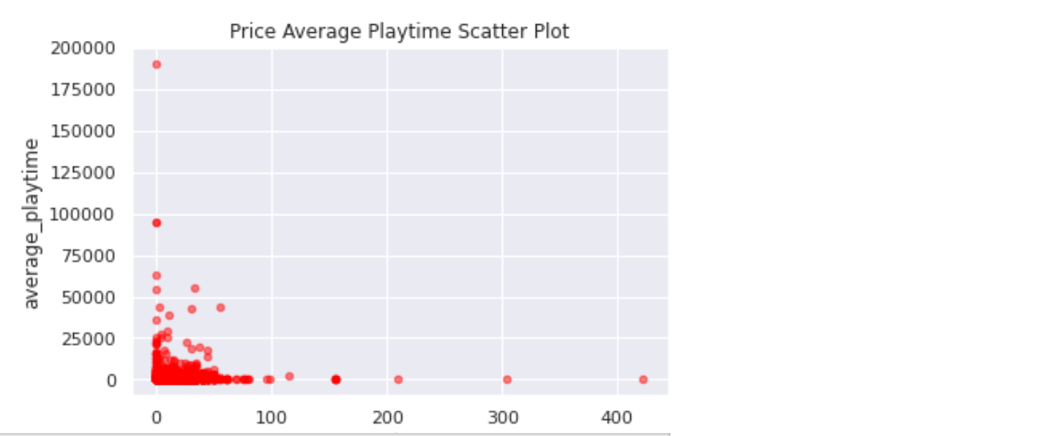
As we can clearly see that the games with most play time are free of cost.
To Analyze whether the price effects playtime or not?

Slide 7
Business Problem # 2
How many publishers are there and who are getting more downloads the ones who release game frequently or the ones who have released hand full of games?

Slide 8
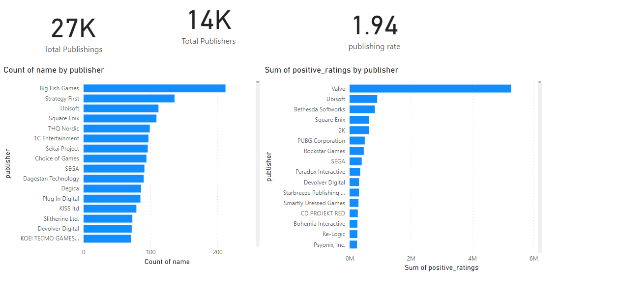
As we can clearly see that the publishers with most publishes are not even in the Top list of publishers with respect to positive reviews.
Quality over Quantity

Slide 9
Business Problem # 3
What is the best month to release a game? And what is the best genre for steam store?

Slide 10
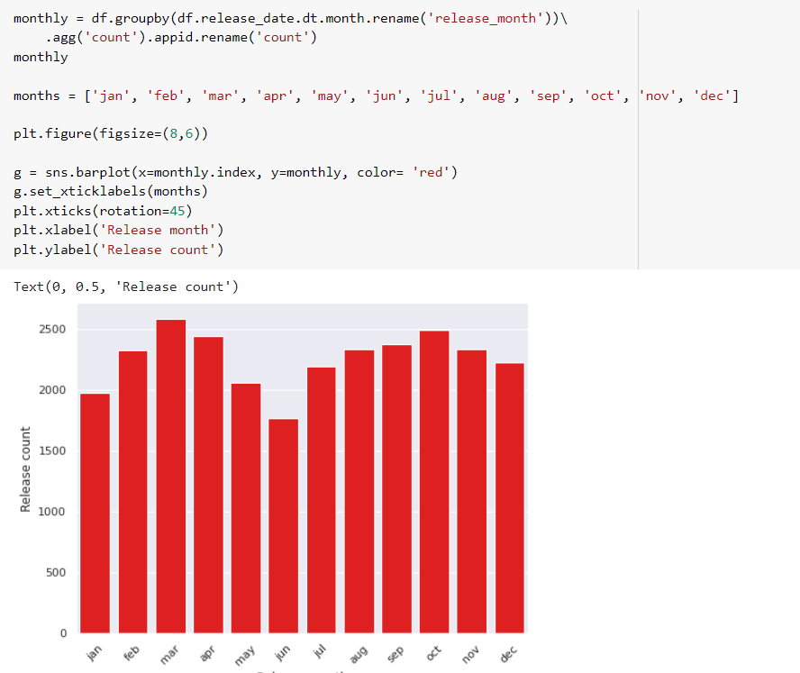
Count of Games w.r.t release month.

Slide 11
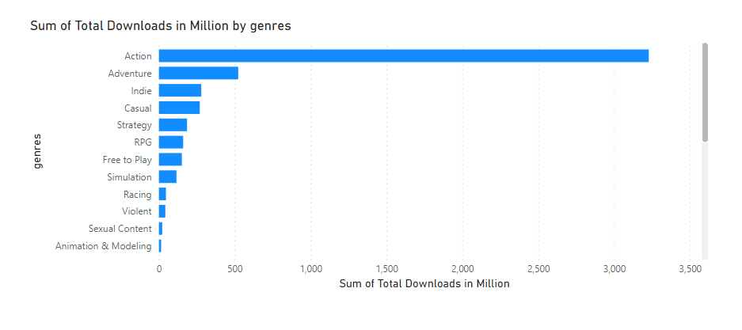
Total Downloads w.r.t Genres
As we can see on both charts that their no specific month for releases but we can see that steam store have huge publishes of Action genre

Slide 12
Business Question # 4
Which are the top 5 games as per positive rating and their publishers and genres and biggest competitor in that genre?

Slide 13
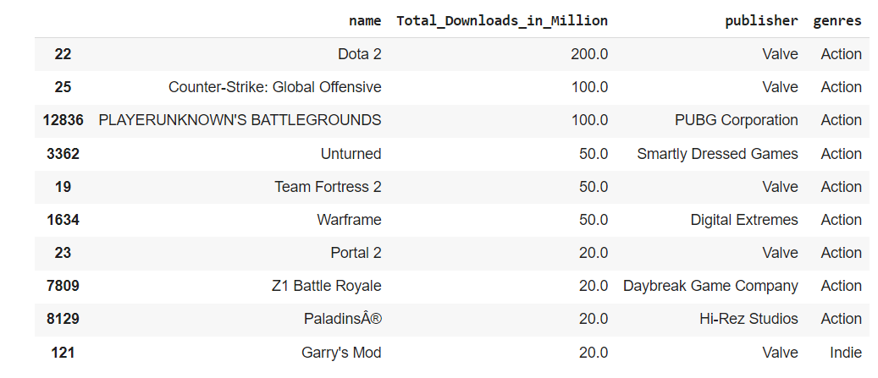
Top publishers and Genre with most downloads
As you can see that 9 out of 10 games are of genre
Action and valve is one of the biggest competitor in this genre.

Slide 14
Business Problem # 5
Does age restriction effects total downloads and does steam have more downloads of single player games or of multi-player games?

Slide 15
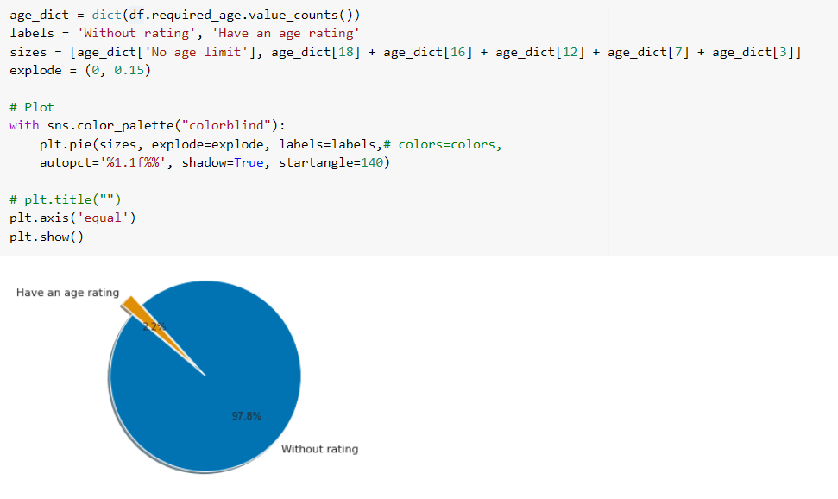
Games with age restrictions

Slide 16
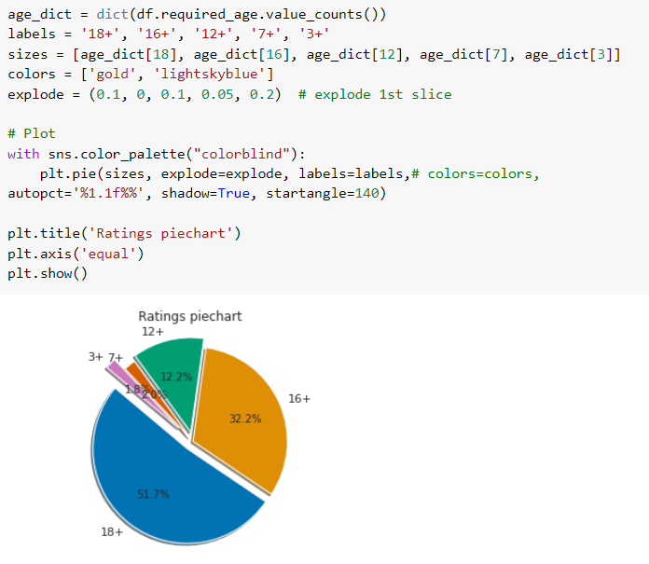
Categorization of Age restricted Games

Slide 17
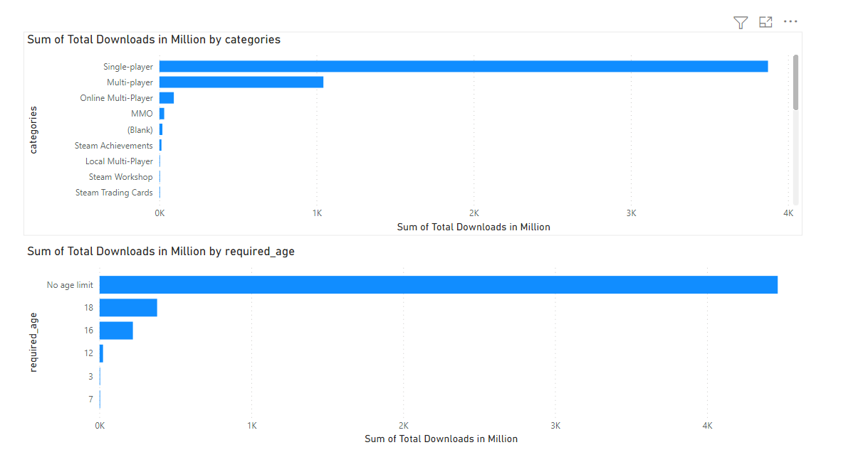
Downloads W.r.t Category and Age Limit
As we can clearly see that single player games and games without age limit have most downloads

Slide 18
My Recommendations
Try to make game related to action.
Make game in such a manner that it can be played by audience of all ages.
Make game available for free.
Make dual mode game so that it can be played by both single user and multiple users.
Study games of Valve and try to study their back concepts and their marketing strategy because they are currently in top 1 tier.
Focus on quality not quantity.

Slide 19
Thank You!

